Slide 1
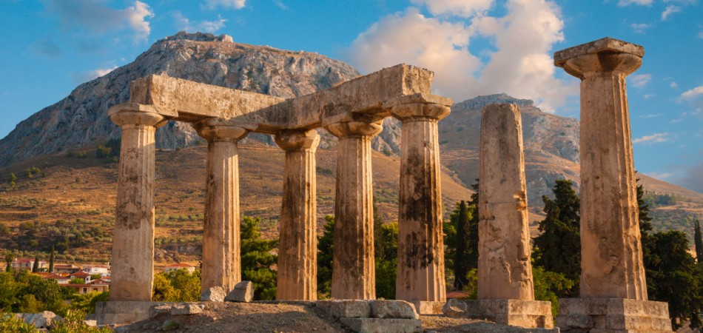
The Epistle of First Corinthians

Slide 2
Outline of 1 Corinthians
SECTION ONE: Dealing with reported problems (1:1—6:20)
A. Unity based on God’s wisdom (1:10—4:21)
Greeting, thanksgiving, and exhortation to unity (1:1-17)
God’s wisdom & power vs. human pride (1:18-31)
Paul’s Example – relying on God’s wisdom and power (2:1-16)
God’s foundation and building (3:1-23)
The quality of Paul’s apostleship (4:1-21)
B. Dealing with sin in the church (5-6)
Dealing with the immoral (5:1-13)
Dealing with those filing lawsuits (6:1-11)
Flee Sexual Immorality (6:12-20)

Slide 3
Outline of 1 Corinthians
SECTION TWO: Dealing with questions and concerns of the Corinthians (7:1--16:9)
C. Their Concerns (7-9)
Marriage problems & issues for singles (7:1-16)
Live as you are called (7:17-40)
Things offered to idols (8:1-13)
The rights and responsibilities of preachers (9:1-27)
D. Common Concerns (10-11)
Old Testament warnings about temptation (10:1-13)
Flee idolatry (10:14-33)
Respecting headship when praying or prophesying (11:1-16)
The Lord’s Supper (11:17-34)

Slide 4
The Lord’s Supper (11:17-34)
Conduct unbecoming of a follower of Christ (11:17-22)
Paul had praised the Corinthians earlier in the letter (11:2) but now is clear in his communication that he does not praise their actions (11:17,22) related to the observance of the Lord’s Supper
Their meeting together should edify (build up), but because of their actions it was tearing down and dividing
Their meeting should promote edification, piety, spirituality, harmony. Instead is was promoting division, alienation, and disorder.

Slide 5
The Lord’s Supper (11:17-34)
Conduct unbecoming of a follower of Christ (11:17-22)
Paul had praised the Corinthians earlier in the letter (11:2) but now is clear in his communication that he does not praise their actions (11:17,22) related to the observance of the Lord’s Supper
There were two (2) main issues that Paul addresses
Divisions and contentions (vs. 18-19)
Abuse and profanity of the Lord’s Supper observance (vs. 20-34)

Slide 6
The Lord’s Supper (11:17-34)
Conduct unbecoming of a follower of Christ (11:17-22)
Divisions and contentions among them (vs. 18-19)
Paul had heard of divisiveness (creation of disunity or dissension) among the Corinthians from the house of Chloe (1:10-12)
Divisions: “skhis’-mah” (schism: division, separation, discord, disharmony)
These actions within themselves would cause factions among them (with those seeking “after self” as compared to those seeking “after God”)
Therefore….

Slide 7
The Lord’s Supper (11:17-34)
Conduct unbecoming of a follower of Christ (11:17-22)
Abuse and profanity of the Lord’s Supper (vs. 20-34)
The Christians were coming together to worship God and partake of the Lord’s Supper, but because of their actions Paul is stating that this could not be their real purpose.

Slide 8
The Lord’s Supper (11:17-34)
Conduct unbecoming of a follower of Christ (11:17-22)
Abuse and profanity of the Lord’s Supper (vs. 20-34)
Practices that were allowed among them could not be a part of the memorial supper for the Redeemer (vs. 20-22)
Not partaking together
Greediness
Gluttonous actions
Shaming others
Not part of the supper instituted by the LORD!

Slide 9
The Lord’s Supper (11:17-34)
The LORD as our example (11:23-26)
Paul describes the what he had received from the LORD and delivered to them
The essence of the Christian’s belief: “Christ died for our sins according to the scriptures, and that He was buried, and that He rose again the third day according to the Scriptures” (15:3-4)
Paul describes the Supper as instituted by the LORD (Ref: Matthew 26:26-28)

Slide 10
The Lord’s Supper (11:17-34)
The LORD as our example (11:23-26)
Paul describes the what he had received from the LORD and delivered to them
Paul is trying to convey the following:
Solemn circumstances in which the Supper was instituted
Object in view: to commemorate the death of the Redeemer
Purpose: NOT a festival, but a memorial; a constant remembrance of Jesus until He comes again

Slide 11
The Lord’s Supper (11:17-34)
Self Examination (11:27-34)
Therefore, (because of what the LORD has done for us), those who partake must do it in the right manner
There is an unworthy manner in which the Lord’s Supper can be taken
It is not about who we are…because we would all be “unworthy”, but it is in reference to how we partake
An unworthy manner would result in guilt of the body and blood of the Lord

Slide 12
The Lord’s Supper (11:17-34)
Self Examination (11:27-34)
Therefore, (because of what the LORD has done for us), those who partake must do it in the right manner
An examination of oneself is necessary to not expose himself of judgement to himself in not discerning the Lord’s body (vs. 28-29)

Slide 13
The Lord’s Supper (11:17-34)
Self Examination (11:27-34)
Therefore, (because of what the LORD has done for us), those who partake must do it in the right manner
It seems that there was some correlation related to their actions and their physical well being (vs. 30)
If one continues to examine oneself and ensure the proper respect and spirit are exercised in our actions, exposure to God’s divine displeasure (judgement) is not received (vs. 31-32)

Slide 14
The Lord’s Supper (11:17-34)
Self Examination (11:27-34)
Therefore, (because of the potential to receive the displeasure of God), those who partake must do it in the right manner (vs. 33-34)
When they come together to partake of the Lord’s supper, there should be no divisions among themselves
They are to have the correct attitudes, respect, sobriety (restraint from excess), and all partake as equals in Christ

Slide 15
Lesson Schedule for our study of First Corinthians Eastside Auditorium Fall Quarter 2017
Wednesday, 8 November
Gifts of Spirit
1 Cor. 12

